Slide 1
Computer Networks
Instructor: Su Hongyi 宿红毅
Tel: 68946645
E-mail: henrysu@bit.edu.cn
School of Computer Science and Technology
Beijing Institute of Technology

Slide 2
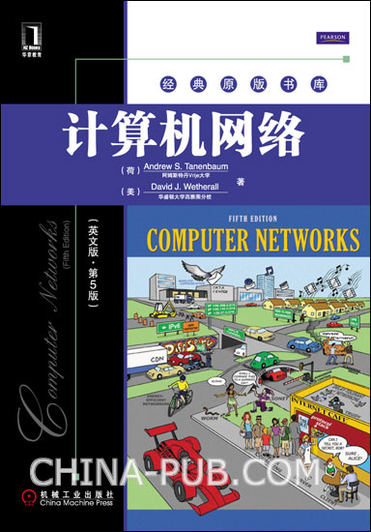
Textbooks and References
Computer Networks, 5th ed
  Andrew S. Tanenbaum
  David J. Wetherall
  Prentice Hall, 2010
  机械工业出版社，2011

Slide 3

Textbooks and References

Slide 4

Textbooks and References
Computer Networking: A Top-Down Approach (5th Edition)
  James F. Kurose, Keith W. Ross
  Addison Wesley, 2009

Slide 5
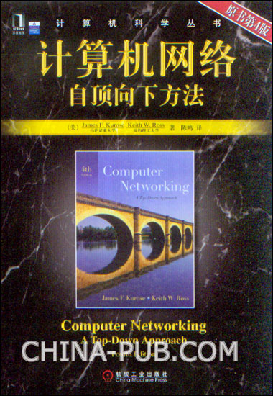
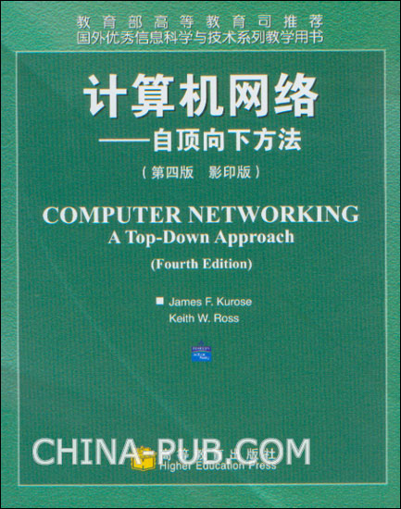
Textbooks and References

Slide 6


Textbooks and References

Slide 7
The purpose of the class
learn and get familiar with the basic concepts and aspects of computer networks;
thoroughly understand network architectures, primary ideas of network engineering, as well as applications;
build up ground work for further study and R&D in computer networks field.

Slide 8
The contents of the class
Systematically teach computer networks principles, include:
  Data communication foundation
  ISO/OSI reference model
  LAN
  TCP/IP Stack
  The Internet
  Management and Security

Slide 9
Grading
Credits
  48 teaching hours with 3 credits
Assignments and Attendance
  Homework is given un-periodically (about once a week).
Grading policy
  20% for assignments and attendance;
  10% for protocols analysis；
  10% for papers；
  60% for final exam.

